Slide 1

New OWASP Top 10 Items - 2017
Stephen Deck, GSE, OSCE, CISSP
@ranger_cha
BE INFORMED. BE STRATEGIC. BE SECURE.

Slide 2
Objective
OWASP Top 10 Update
XML eXternal Entity (XXE) Background
XXE Defense and Attacks
Deserialization Background
Deserialization Defense and Attacks
New Deserialization Research
Logging & Monitoring
Notes:
This presentation covers two of the new attacks that are included in the 2017 OWASP top 10 that were not included in previous OWASP top 10 versions. The two we will cover are XML external entity and deserialization attacks. Both of these vulnerability types are covered from the perspective of creating, finding, exploiting, and fixing. We will also cover some information about deserialization attacks that will likely lead to further attacks in this category. Finally, we will discuss logging and inclusion of this test and how it affects application security testing.

Slide 3
2017 OWASP Top 10

Slide 4
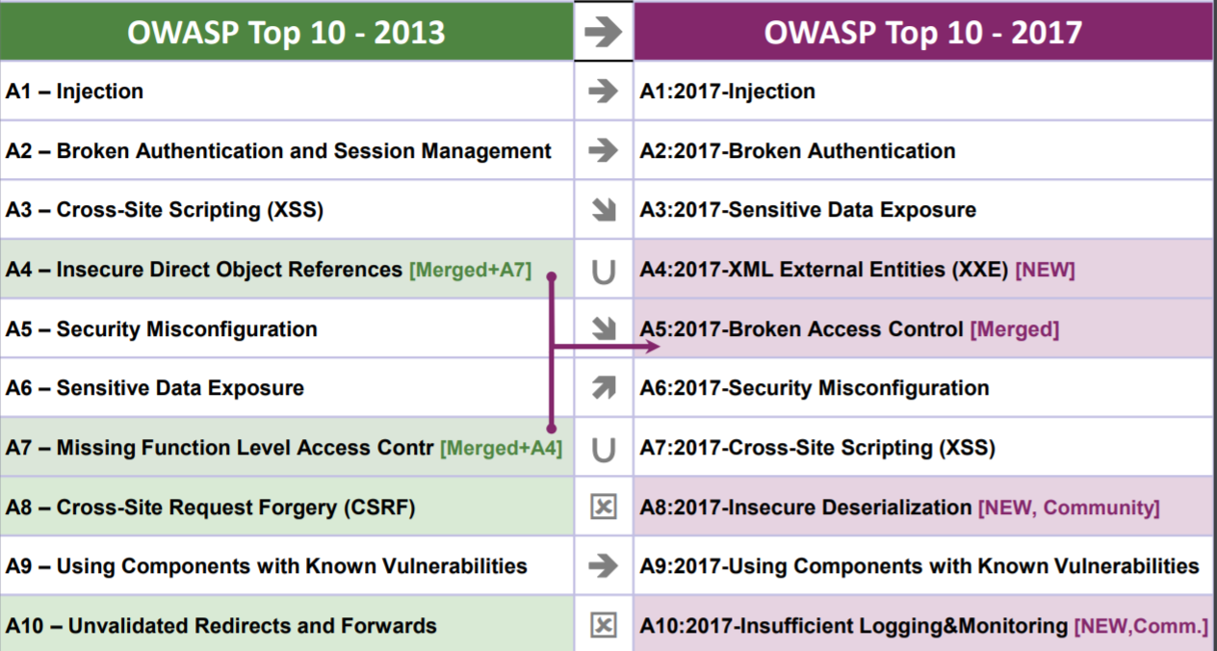
OWASP Top 10 2017
Source: https://www.owasp.org/images/7/72/OWASP_Top_10-2017_%28en%29.pdf.pdf
Notes:
The OWASP top 10 has been the standard list for “what to check” in web security since 2004. Every 3-4 years this list is updated with what are supposedly the top 10 vulnerabilities afflicting web applications. As an application security consultant, questions about these vulnerabilities have been included in every interview I’ve ever had. For anyone who wants to get into the field, the OWASP top 10 are considered baseline knowledge. Even for individuals that are not focused on AppSec, it is helpful to understand vulnerabilities of all types. Penetration testers need to understand what each vulnerability category is capable of accomplishing in order to best determine how to use exploits. Individuals involved in enterprise vulnerability management can use this knowledge to prioritize vulnerabilities for remediation or to assist in creating mitigating controls. Software developers cannot hope to avoid vulnerabilities without a strong understanding of how the vulnerabilities work.
The last official update to the OWASP top 10 list occurred in 2013. This year the top 10 project has just released a new update. The first release candidate from this summer was rejected due to the inclusion of a controversial new rule. The project leaders stepped down, the list was revamped, and became release candidate 2. RC2 includes three attacks that were not part of the 2013 top 10 list. These are XXE, Insecure Deserialization, and Insufficient Logging & Monitoring.
The first two are older attack classes that have become far more prevalent since 2013. Each of these vulnerabilities have been known for several years, but few tools were available to the community to detect and fully exploit them. This will be the focus of today’s discussion.
The “Insufficient Logging & Monitoring” class of vulnerabilities is pretty simple to understand. However, this is a radically different type of finding compared to the rest of the OWASP top 10. So we will cover exactly what this means for conducting tests.

Slide 5
XML eXternal Entity (XXE)

Slide 6
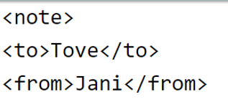
What is XXE?
XML eXternal Entity (XXE)
XML is not just for data storage
Possible to supply Document Type Definition (DTD)
Use DTD to create programmatic elements
Refer to these elements in the XML
Often the default
Code execution MAY be possible
Notes:
XXE stands for XML eXternal Entity. First, XML is a markup language that’s often used to provide a common format for data exchange. This markup language allows you to specify “external entities.” This means that in an XML document, we can specify “entities” – or references – that come from just about anywhere. This includes external entities that refer to something outside of the XML document. To get even crazier, we can use a document type definition, or DTD, to do some basic programming. Then you can call these elements in your XML file. Enabling these DTDs is the default for many XML processors. With XXE it is possible to get code execution in some cases.

Slide 7
XXE Defenses
Do not allow DTD
In PHP, do not allow expect
Maybe don’t use PHP?
That’s pretty much it.
Notes:
Remediating XXE findings is not terribly complicated. In the application’s XML processor, just disable DTDs or use a local, static, DTD. If using PHP, just change to a different language. In PHP you also shouldn’t have the “expect” module loaded. That’s pretty much it. XXE is really kind of anti-climactic compared to some of the other vulns that really require a lot of thought to remediate. Allowing custom DTDs is almost never a requirement. This is one of the vulnerabilities like buffer overflows that drastically drops off in the future as the secure state becomes the default.

Slide 8
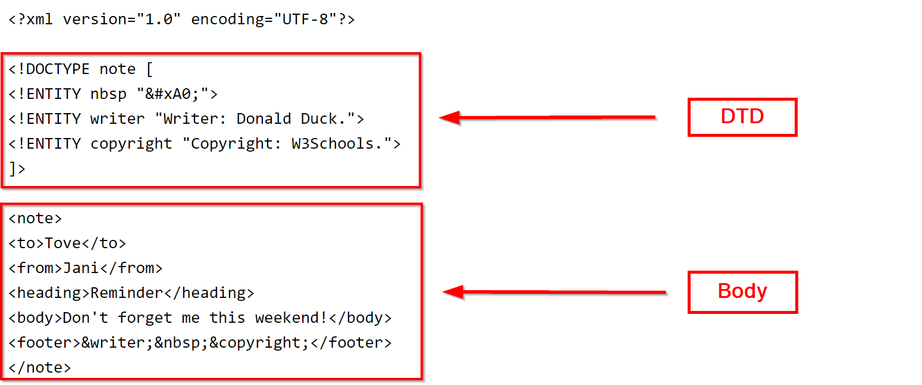
XML Format

Slide 9
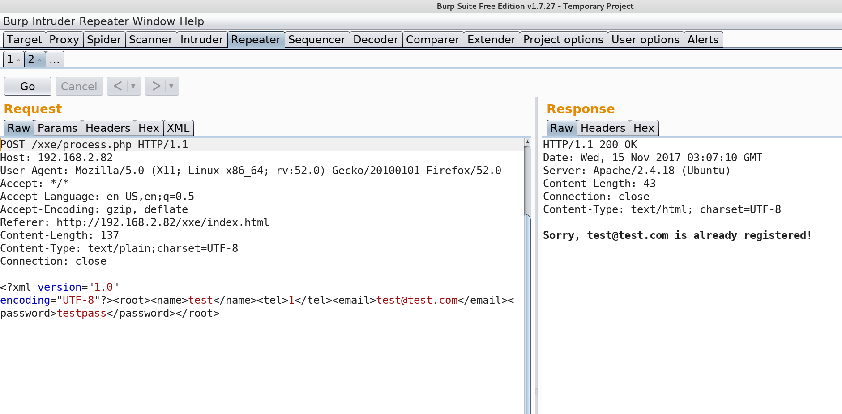
XML POST

Slide 10
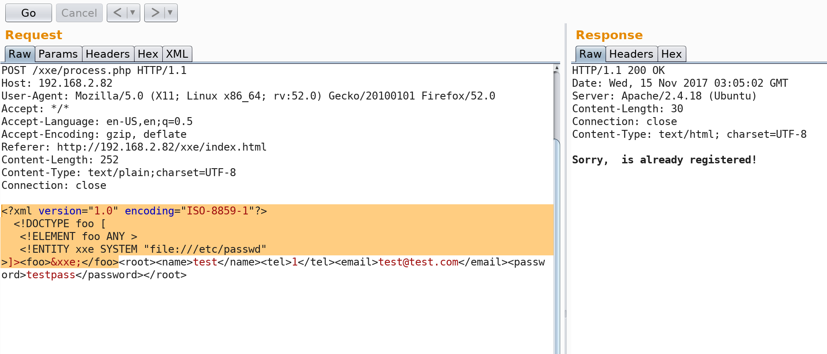
XML with an External Entity

Slide 11
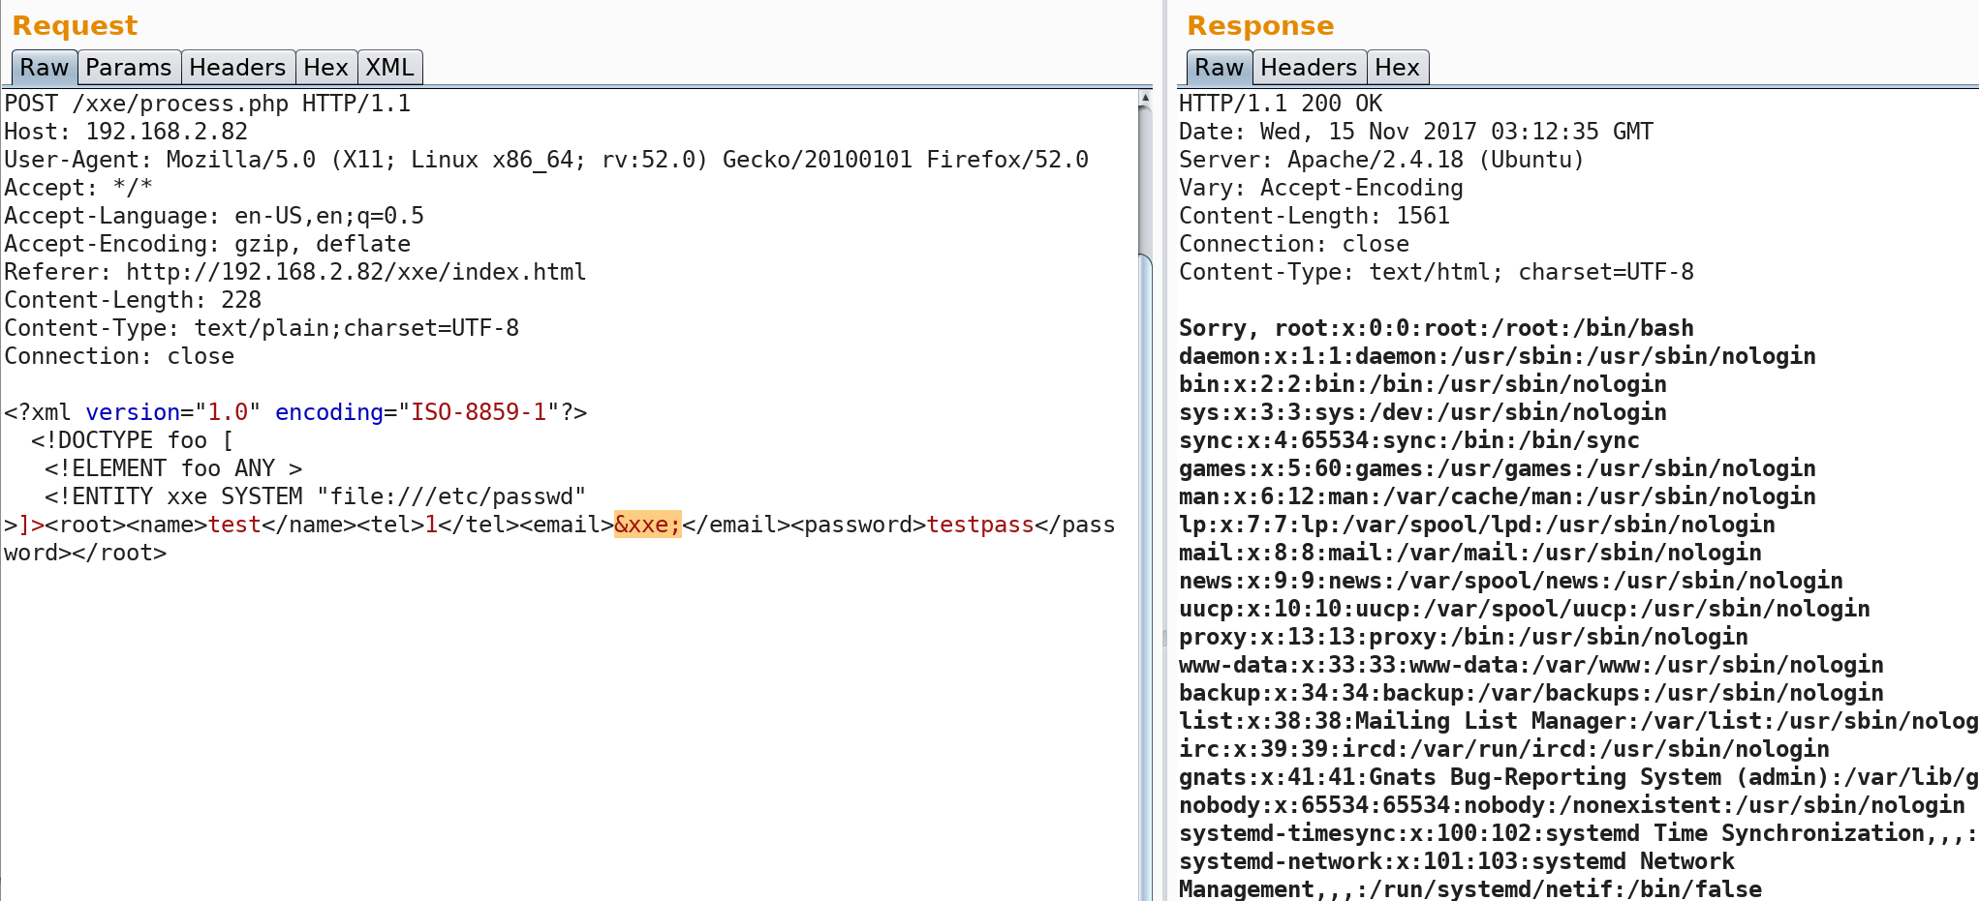
XML with an External Entity

Slide 12
Insecure Deserialization

Slide 13
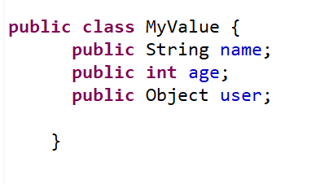


Serialization from the beginning…
What is an object?
Collection of values that works as a single unit

Slide 14
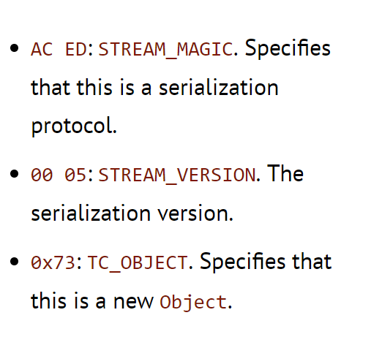
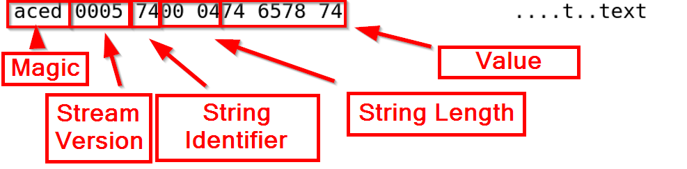

Serialization from the beginning…
Process of preparing objects for network transport
Also called marshalling
What does serialization look like?
Source: https://www.javaworld.com/article/2072752/the-java-serialization-algorithm-revealed.html
Notes:
What do serialized objects look like? Here is a string with the word text. After serializing the object we have several parts. First is the magic value. This is an indicator that the following data is a serialized object. The stream version is an identify to notify the application which format the data are in. Next we have an identifier of the data type for the object that is following. This value will depend on exactly what information is coming next. For example, 0x74 indicates that the next object is a string. 0x73 indicates that the next object will be of type “object.” Strings are composed of a length identifier. In this case, 0x04, indicating the next 4 bytes are the string value. Here we have 0x74657874, which corresponds to the ascii characters “text”

Slide 15
Deserialization
Deserialization is the reverse of serialization
Usually from a readObject call (in Java)
Common in many languages
Force server to load an unexpected object
Often execute arbitrary code
Notes:
Now that we’ve seen serialized data, it is simpler to understand how deserialization works. All those bytes are parsed by the deserialization routine. This is a common practice in many languages. Python, Java, .NET, etc. It may not always look like the bytes we saw in the previous slide, but it is happening. In Java, this is usually done with the readObject method.
So what? Why is it an issue that we can send objects to a server? How is this pertinent to security at all? Like always, you can never trust a client. It is possible for an attacker to send a different object than the one expected by the server. Some possible attacks would be to provide a different data type. So instead of an integer with our user ID, we provide a Boolean variable, like true. Something like that might grant the ability to bypass authentication.
Sometimes it is even possible to execute arbitrary code with deserialization exploits. Some objects can come pre-packaged with commands to run code or make requests on a victim server.

Slide 16
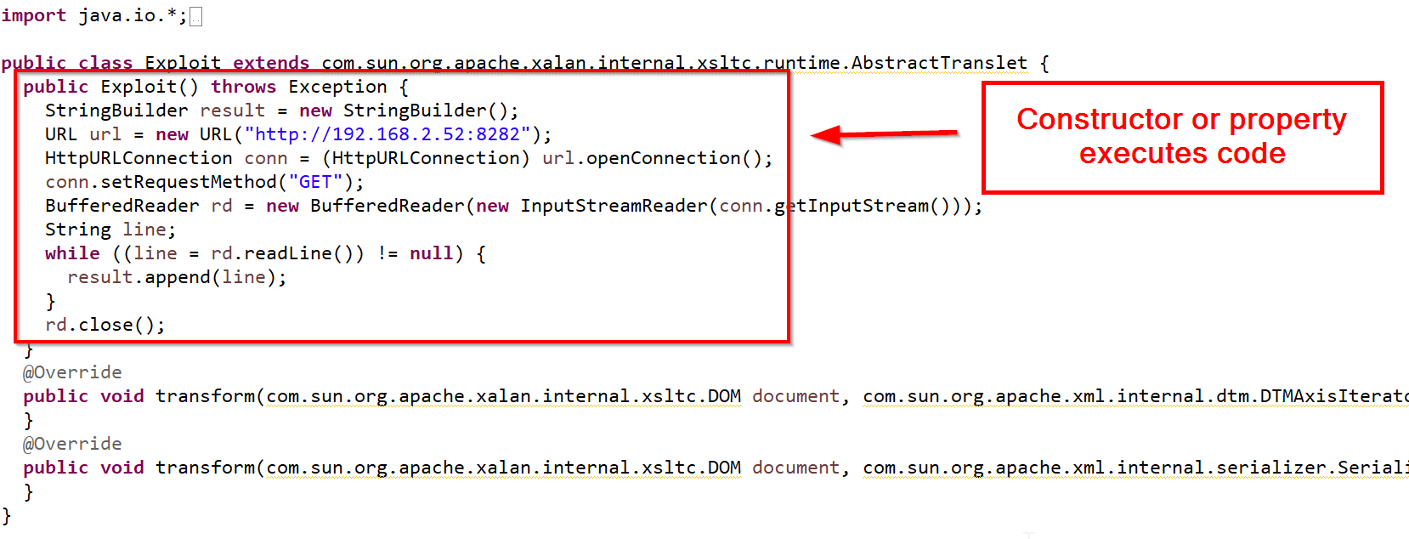
Malicious Objects
Source: https://adamcaudill.com/2017/10/04/exploiting-jackson-rce-cve-2017-7525/
Notes:
This is an example of a malicious object. It will only make an HTTP request to a site of our choosing. We’re using the xalan XSLTC AbstractTranslet class’s constructor to execute our code when the object is created.

Slide 17
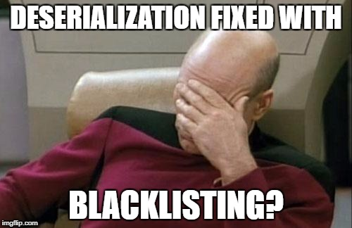
Deserialization
How do you fix it?
Upgrade for…
Blacklisting???
Nooooo
Hard to write signatures
Notes:
So the fix for these vulnerabilities has been blacklisting classes that are deserialized. Normally, blacklisting is not appropriate. It is just a matter of time until someone finds a different gadget that bypasses the blacklist. Unfortunately, Java developers actually do want to write custom classes and then deserialize them. So you can’t just specify classes that are safe to deserialize or the Java developer’s classes definitely won’t be in that list. So sadly enough, blacklisting is the best defense available and the only way to get the blacklisting is to upgrade. The deserialization functions are also not the only piece of code you’ll be stuck upgrading. For example, the Jackson marshaller is probably going to be included in a larger framework. So to get the fix in, the framework has to update and then you have to use the newer framework version. This means that the developers need to test the new framework or the app may not function properly. So this isn’t a trivial fix.
It is also difficult to write signatures for network security gear that will effectively block deserialization attacks. Again, you are trying to blacklist specific objects. You also have to do it without the benefit of an IPS preprocessor that understands Java objects. Even if you did have an IPS preprocessor for it, it would likely be vulnerable to a deserialization attack. Then you would end up with code execution on your IPS, which is never a good thing.

Slide 18
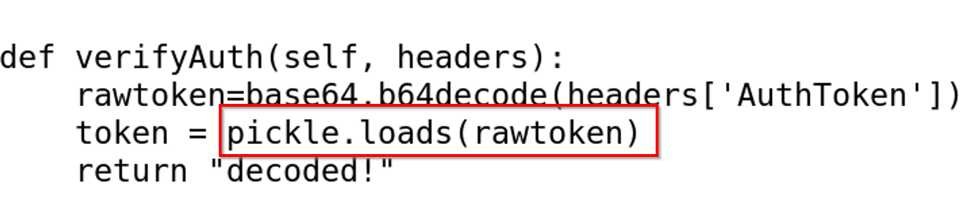
Pickle Deserialization
https://blog.nelhage.com/2011/03/exploiting-pickle/
Look for deserialization calls
Notes:
The pickle library in python handles deserialization. Here is a screenshot of the pickle.loads method that performs the deserialization. This routine runs on a base 64 encoded AuthToken header.

Slide 19
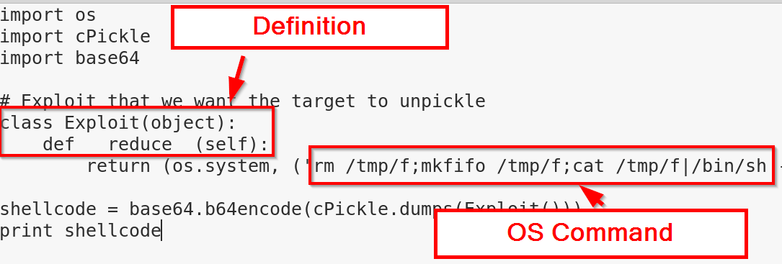
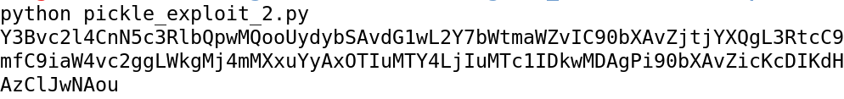
Pickle Deserialization Exploit Class
Create a class that executes code when created
Notes:
Since an attacker can control this header, the attacker can make a Python object that executes operating system commands. In this case we are using operating system commands to run a reverse shell to our attacker machine. By running this code, we have a base64 encoded version of this object.

Slide 20
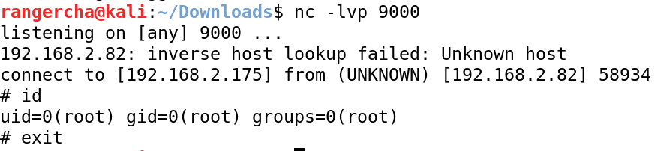
Pickle Send Exploit
Send exploit to server
How depends on the app
Notes:
Now when we send our object to the server we can see that the server sends back a shell that we can use to execute further OS commands as root.

Slide 21
Deserialization in Java
Look for raw Java objects
Find a suitable gadget (object to run code when loaded)
Must be an object the app understands
Ysoserial provides several gadgets
https://github.com/frohoff/ysoserial
Notes:
Java has similar problems to the Pickle library. Many deserialization vulnerabilities lay dormant for years due to a lack of effective gadgets to execute code. In 2015, researchers created a Java application called ysoserial to help other security testers exploit these Java deserialization vulnerabilities.

Slide 22
Deserialization in Java
Vulnerable app
https://github.com/hvqzao/java-deserialize-webapp
Includes Apache Commons Collection
Ysoserial exploit only runs one command
Reverse shell in three commands
wget IP/meterpreter
chmod +x meterpreter
./meterpreter
Notes:
To demonstrate this, we’ll use a vulnerable app that deserializes arbitrary user objects. This app includes the Apache Commons Collection, which many apps use. This collection contains a gadget that allows the execution of arbitrary code. Using ysoserial to generate the payload, we can execute a single command with each request. We will run the attack in three stages. The first will download our malicious code, the second will make our malicious code executable, and the third will run the executable.

Slide 23
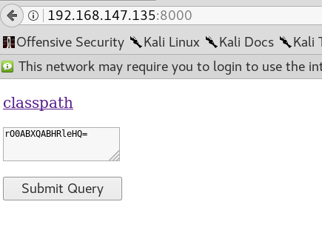
Deserialization in Java Example

Slide 24
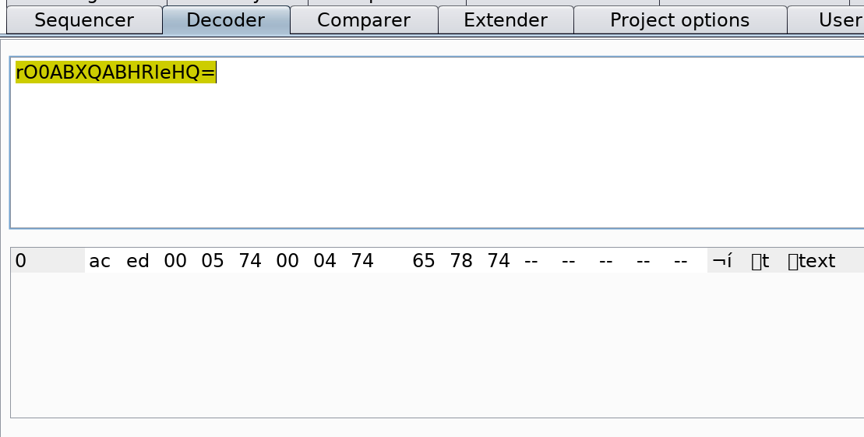
Deserialization in Java Example

Slide 25
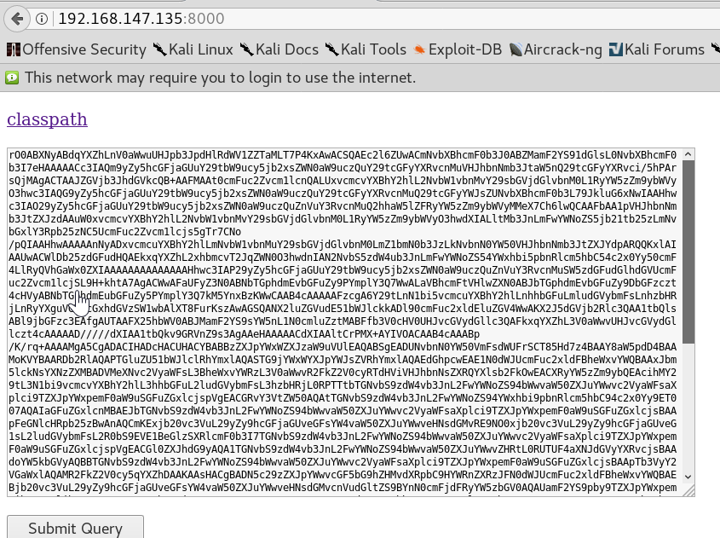
Deserialization in Java Example

Slide 26
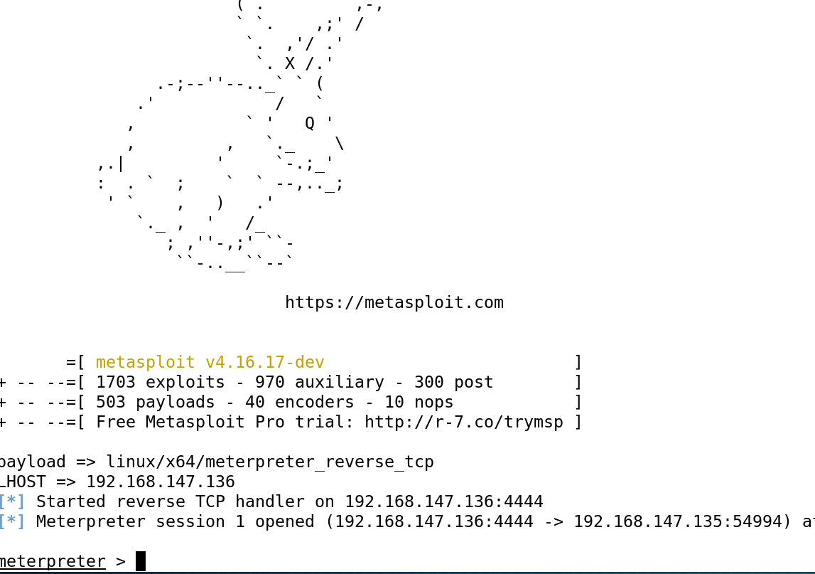
Deserialization in Java Example

Slide 27
No Java Objects?
Safe without Java objects?
Moar gadgets
https://github.com/mbechler/marshalsec
Same idea, different format
JSON, XML

Slide 28
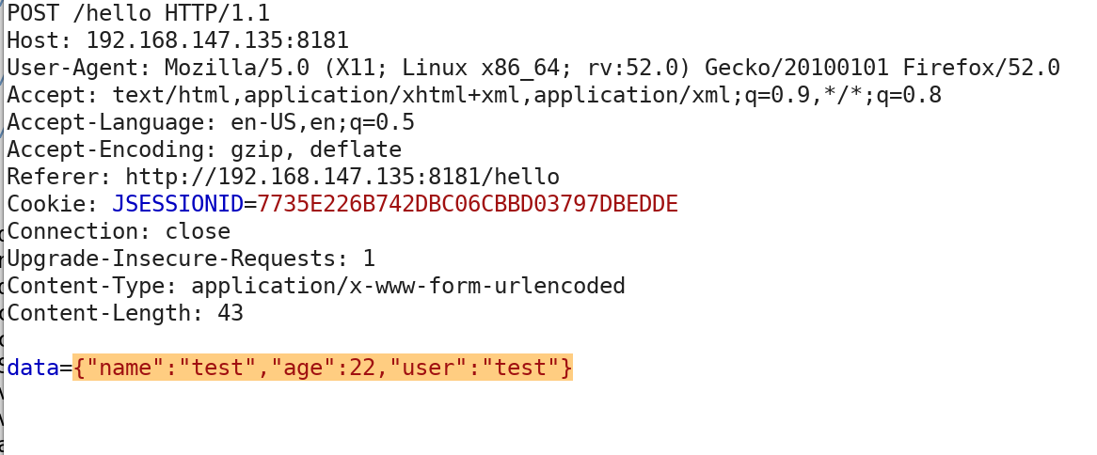
Jackson Deserialization

Slide 29
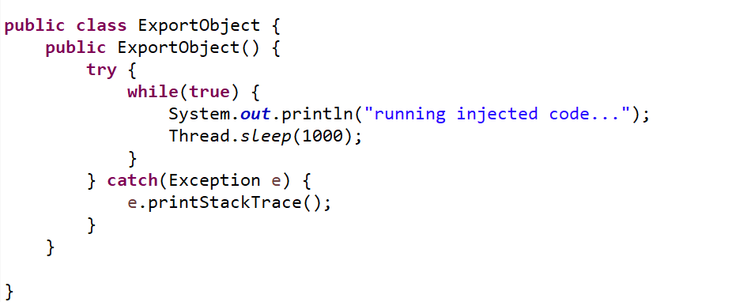
Jackson Deserialization

Slide 30
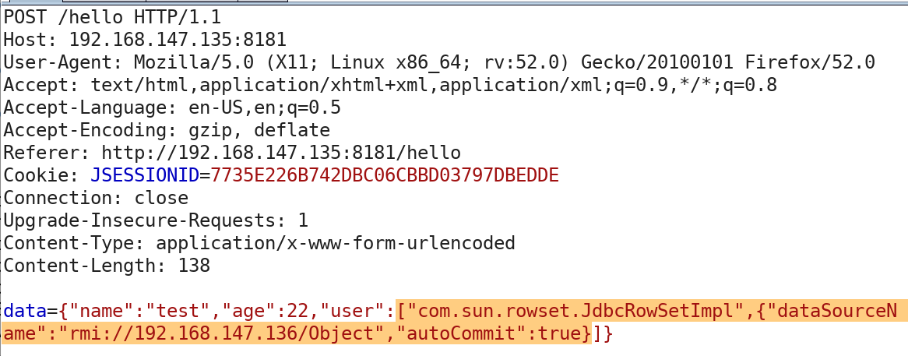
Jackson Deserialization

Slide 31
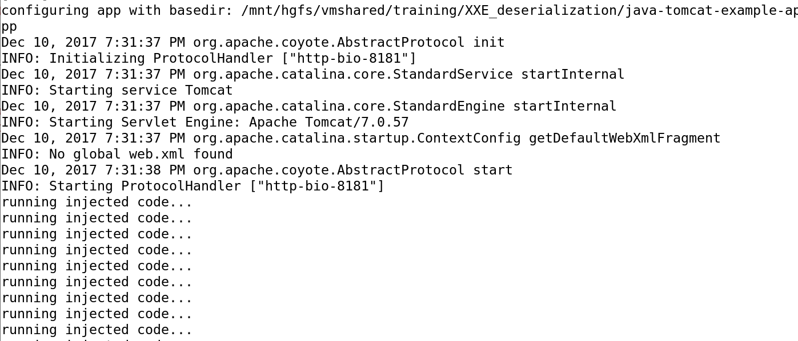
Jackson Deserialization

Slide 32
Insufficient Logging and Monitoring

Slide 33
Insufficient Logging & Monitoring
Ensure defenders can:
Identify attacks
Investigate incidents
191 days to identify a breach
Requires blue team participation
Kind of awkward for AppSec testing
Cannot run 0 involvement “Top 10” test
Source: https://www-01.ibm.com/common/ssi/cgi-bin/ssialias?htmlfid=SEL03130WWEN&
Notes:
Insufficient Logging and Monitoring is specifically to address the length of time it takes to detect a breach. In 2016, Ponemon said breaches took an average of 191 days to catch. Many organizations are now consuming logs from most of their devices – especially Windows and Linux servers. This is fantastic, but for applications, there is no guarantee that they are writing the logs that are necessary and that these logs are also being consumed by corporate log management solutions and analyzed. The issue with adding this to the OWASP top 10 is that it is no longer feasible to test all the OWASP top 10 vulnerabilities without a company’s blue team notifying software testers when their activities are detected.

Slide 34
Insufficient Logging & Monitoring
Things to log
Failed & successful authentication attempts
Software errors
Security tool alerts
Sensitive actions (money transfers, password changes)
Logs must be aggregated
Blue teams should alert
Notes:
Insufficient Logging and Monitoring is specifically to address the length of time it takes to detect a breach. In 2016, Ponemon said breaches took an average of 191 days to catch. Many organizations are now consuming logs from most of their devices – especially Windows and Linux servers. This is fantastic, but for applications, there is no guarantee that they are writing the logs that are necessary and that these logs are also being consumed by corporate log management solutions and analyzed. The issue with adding this to the OWASP top 10 is that it is no longer feasible to test all the OWASP top 10 vulnerabilities without a company’s blue team notifying software testers when their activities are detected.

Slide 35
Summary
OWASP Top 10 now includes three new vulns
XXE
Deserialization
Insufficient Logging & Monitoring
Fix XXE by disallowing DTDs
“Fix” Deserialization by blacklisting classes (need patch)
Fix logging and monitoring by… logging and monitoring
Need client support to test

Slide 36
References
New OWASP Top 10 (2017)
https://www.owasp.org/images/7/72/OWASP_Top_10-2017_%28en%29.pdf.pdf
Example XXE App
https://github.com/jbarone/xxelab
Setup RMI Object
http://zerothoughts.tumblr.com/post/137769010389/fun-with-jndi-remote-code-injection

Slide 37
References
Deserialization Resources
https://github.com/GrrrDog/Java-Deserialization-Cheat-Sheet/blob/master/README.md
Marshalling Pickles
http://frohoff.github.io/appseccali-marshalling-pickles/
ysoserial
https://github.com/frohoff/ysoserial
Deserialization – Different marshallers
https://github.com/mbechler/marshalsec

Slide 38
References
Pickle Deserialization
https://blog.nelhage.com/2011/03/exploiting-pickle/
Java Deserialization app
https://github.com/hvqzao/java-deserialize-webapp
Jackson Deserialization
https://adamcaudill.com/2017/10/04/exploiting-jackson-rce-cve-2017-7525/

Slide 39
Questions?

Slide 40
www.directdefense.com

